Slide 1


AI STYLIST
Automate the work of a clothing personal stylist

Slide 2
1
ABSTRACT
Everyone loves to style. Having a personal stylist who curates a selection of outfits to help individuals feel comfortable and great is desirable but inaccessible to most. AI Styling now auto-cares for this process by providing intelligent outfit recommendations using advanced deep learning techniques. Our AI Styling tool harnesses a hybrid DNN model that is capable of understanding fashion aesthetics and suggesting complementary outfits based on user input. This tool aims to redefine personal styling by making it more accessible and efficient through AI-driven insights. The project also involves complete Exploratory Data Analysis and advanced image processing techniques for providing accurate and meaningful recommendations. The dataset has 44,424 rows and 10 columns, which is the basis for the model building. The dataset for this project shows the growing e-commerce industry, with a wide array of data ready to be analysed. It includes high-resolution product images shot professionally and multiple label attributes describing the products, along with descriptive text that highlights the product characteristics. Each product is given a unique ID and catalogued in a structured manner within the dataset.

Slide 3
2
OVERVIEW
Introduction
Methodology
Future Improvement
Objectives
Result
References
Proposed Solution
Conclusion

Slide 4
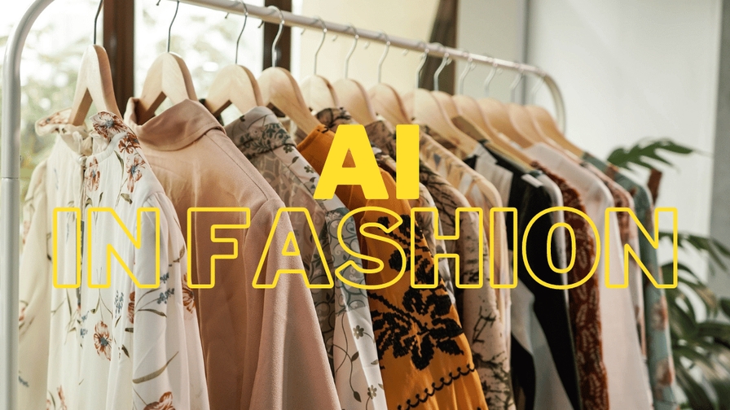
INTRODUCTION
3
Personal Styling Enhances confidence and ensures individuals feel comfortable and fashionable.
Artificial Intelligence automates personal styling by analyzing tends, preferences and user-item interactions making it more efficient and accessible.
AI Personal Stylist System uses content based, collaborative filtering and deep learning techniques to identify good style patterns.
Provides personalized suggestions, reducing reliance on human stylist.
Combines AI with Fashion expertise for a seamless shopping experience.

Slide 5
4
OBJECTIVES
Smart Recommendations
Fashion Compatibility
Providing users with relevant, context-aware clothing recommendations based using product attributes and a Deep Neural Network model.
Leveraging AI to suggest aesthetically cohesive and practical clothing combinations that align with user preferences and enhance decision-making efficiency.

Slide 6
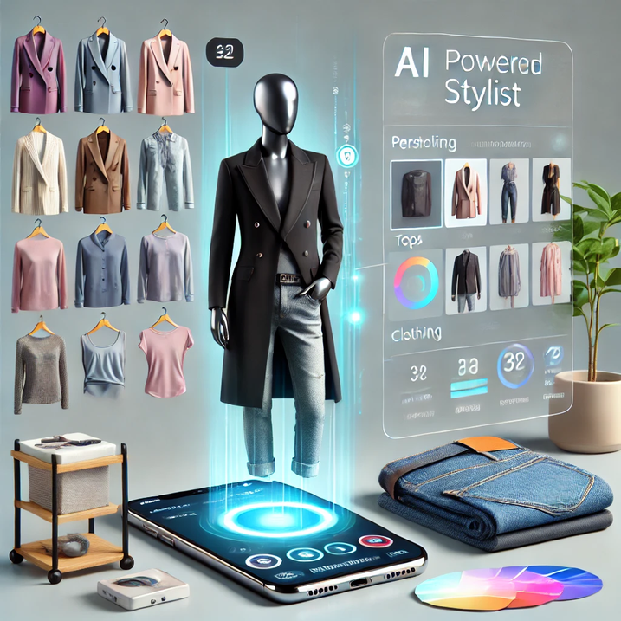
5
PROPOSED SOLUTION
Our solution leverages advanced machine learning techniques to build an intelligent recommendation system. By utilizing content-based filtering, we analyze product attributes such as article type, color, and subcategory to suggest highly relevant items. Complementary item recommendations are further enhanced through a Deep Neural Network (DNN) model, enabling accurate identification of matching products. The system incorporates encoding and scaling techniques to process categorical data efficiently, ensuring robust and scalable performance. This approach aims to provide a seamless and personalized shopping experience, while driving customer satisfaction and business growth.

Slide 7
7
MILESTONES
Milestone 1
Milestone 2
Data Collection: Gather relevant data.
Data Exploration: Clean, augment, and visualize data patterns.
Model Building: Implement content-based and collaborative filtering.
Advanced Techniques: Combine collaborative and content-based features using DNN.
Milestone 3
Milestone 4
Consider Recall@K, Precision@K, and F1@K to assess the quality of the recommendations
Create a presentation covering key project details.
Document the project with in-depth explanations.

Slide 8
8
METHODOLOGY
Data Collection
Content-Based Filtering
Collect user interaction data (e.g.,
clicks, ratings, reviews).
Gather product attributes (e.g., category, color, season, price).
Encode item attributes (category, color, price) using embedding layers.
Calculate similarity to recommend similar items.
Data Preprocessing
Collaborative Filtering
Clean data by handling missing values and outliers.
Normalize and augment data for consistency and suitability.
Learn user and item embeddings from interaction data.
Compute interaction scores using the dot product of embeddings.

Slide 9
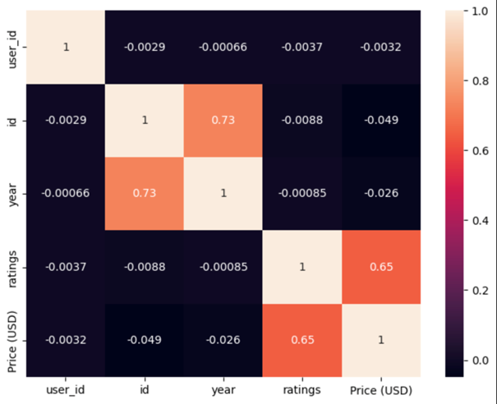
9
METHODOLOGY
Hybrid Model with DNN
Combine collaborative and content-based features.
Train a deep neural network to predict recommendation scores.
Evaluation
Evaluate using metrics like Recall@K, Precision@K, and F1@K

Slide 10
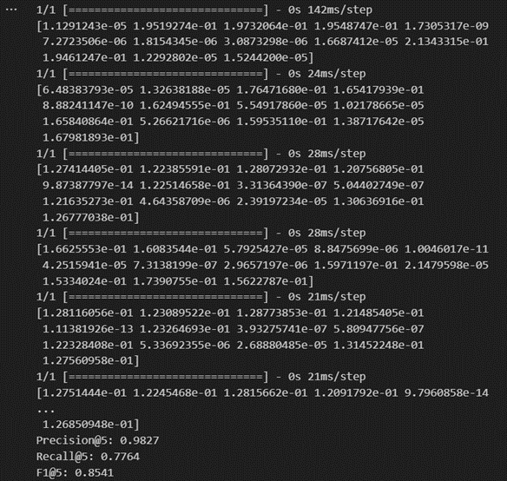
10
﻿RESULT
The performance of the hybrid Deep Neural Network (DNN) model was evaluated using ranking metrics: Recall@K, Precision@K, and F1@K. These metrics are crucial for understanding the quality of recommendations, especially in scenarios where relevance and ranking play a significant role in user satisfaction.
Evaluation Results:
Using the test dataset, the following metrics were calculated for K=5:
·Average Precision@5: 0.9820
·Average Recall@5: 0.7757
·Average F1@5: 0.8531

Slide 11
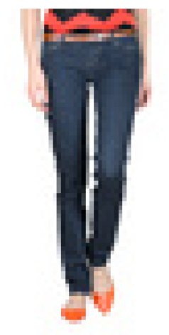
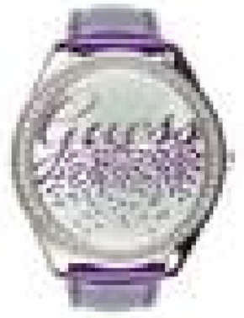
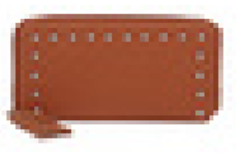
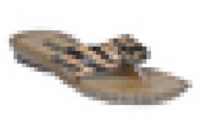
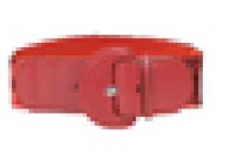
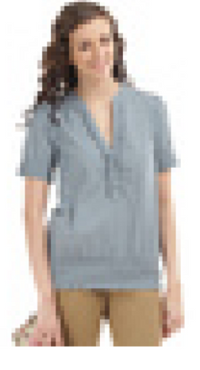
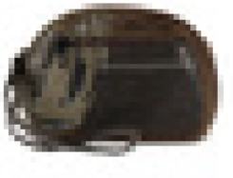
11
RECOMMENDATIONS
Main Item
Recommended Items

Slide 12
12
CONCLUSION
The AI Stylist project revolutionizes personal styling by seamlessly integrating deep neural networks (DNN) with a hybrid approach that combines content-based and collaborative filtering. This advanced system delivers precise, diverse, and personalized outfit recommendations tailored to user preferences, body types, and specific occasions. By incorporating real-time virtual try-ons, it allows users to visualize outfits before making decisions, bridging the gap between traditional shopping experiences and cutting-edge technology.
A core focus of the project is promoting sustainable fashion by encouraging wardrobe optimization and eco-conscious choices, meeting the growing demand for environmentally responsible solutions. The AI Stylist streamlines the styling process, saves time, and offers trend-aware suggestions, fundamentally transforming how individuals engage with fashion.
Beyond personal use, this innovation holds transformative potential for the fashion retail and e-commerce industries, offering scalable and personalized solutions that enhance customer satisfaction. By establishing a strong foundation for AI-driven applications in fashion, the project paves the way for a smarter, more inclusive, and sustainable future in personal styling.

Slide 13
13
FUTURE IMPROVEMENTS
ENHANCED VIRTUAL TRY-ON EXPERIENCE
Incorporate advanced 3D modeling and augmented reality (AR) for lifelike visualizations, simulating fabric drape and movement, enhancing user confidence in outfit choices.
REAL-TIME TREND INTEGRATION
Deploy algorithms to track social media, fashion blogs, and online stores, ensuring recommendations align with emerging fashion trends.
DIVERSITY & INCLUSIVITY
Expand datasets to feature diverse cultural styles, body types, and gender-neutral options, creating a more inclusive experience for all users.
SUSTAINABILITY METRICS
Introduce sustainability scores in recommendations, empowering users to make eco-conscious choices based on material impact and brand ethics.
CROSS-PLATFORM E-COMMERCE INTEGRATION
Seamlessly connect with leading e-commerce platforms, allowing users to browse, try on, and purchase recommended items in one unified system.

Slide 14
14
REFERENCES
FRAMEWORKS AND TOOLS​
TensorFlow: Large-scale machine learning framework. ​
Keras: Deep learning API for neural network modeling. ​
Seaborn & Matplotlib: Visualization libraries for exploratory data analysis. Seaborn, Matplotlib​
OpenCV: Open-source library for computer vision tasks. ​
JOURNALS​
He et al., 2017. Neural collaborative filtering for recommender systems. WWW Conference.​
Aggarwal & Zhai, 2012. Survey of text clustering algorithms. Springer.​
Wang et al., 2018. Graph-based collaborative filtering. IEEE Transactions.​
Krizhevsky et al., 2012. ImageNet classification using CNNs. NeurIPS.​
Abadi et al., 2016. TensorFlow system overview. USENIX OSDI.​

Slide 15
THANK YOU

